Slide 1
Real world writing purposes: Express and Reflect

Slide 2
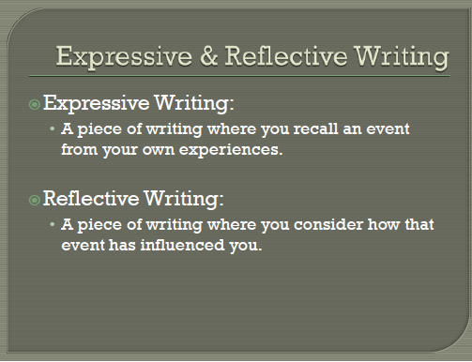

Slide 3
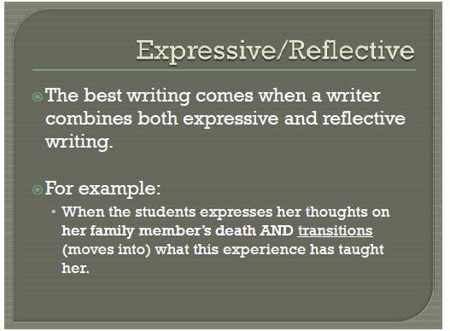

Slide 4
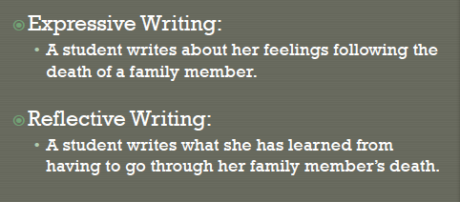
For example:

Slide 5

Good reflective writing

Slide 6
